Slide 1
The Coach Approach to Adaptive Leadership: Changing The Conversation
Mark Durgin, Director, PA Care Partnership
The Coach Approach to Adaptive Leadership was Created and Instructed by the Coach Approach Partners, LLC.
Notes:
5 Minutes
Mark to Open to start with big picture thinking.
Emphasized Diversity
Not just for one type of person.
Actualizing to make this happen.
Marks vision to show for the state.
Special Thanks to Beth Greenland, Ellen Kagen, and Alex Greenland

Slide 2
Leadership can come from any chair

Slide 3
Brief History Of Coach Approach to Adaptive Leadership in Pennsylvania
Adaptive Leadership for System Change
Began in 2017 with 68 Grant Leaders, System Leaders, Youth and Family
Coach Approach to Adaptive Leadership
Followed by 57 Grant Leaders, System Leaders, Youth, and Family in 2018
Train the Trainer Coach Approach to Adaptive Leadership
8 Trainers (Grant Director, 3 State Staff, 3 Family Members, 1 Contractor)
Two Year Training and Certification Process with hands-on delivery
Development of Longitudinal Evaluation
Continued Training and Education through Webinars and Learning Circles
As of April 2023, over 1047 have been trained in the Coach Approach to Adaptive Leadership in Pennsylvania

Slide 4
Our Goals in the Pennsylvania System of Care:
To strengthen our services to the children and families in Pennsylvania systems of care
To improve cross-partnership communication and collaboration as systems of care
To support health and human services organizations, family, and youth organizations in building coaching skills as core skills for leaders
To develop critical thinking skills of youth, family and systems
To support staff retention and empower those with work with and for

Slide 5
The Coach Approach Expectations
Outcomes/achievements are reached more quickly
Staff develop critical thinking skills
Knowledge and skills of staff are tapped; morale is boosted
Managers’ stress is reduced – people answer their own questions
The Coach Approach is aligned with system of care practice and models a strengths-based approach

Slide 6
Coaching and other Forms of Support
 | Mentoring | Consulting | Therapy | Coaching
Method | Advise | Analyze | Assess and Treat | Empower
The Focus | The Future | The Future | The Past | The Present and Future
Who has the Expertise | Mentor | Consultant | Therapist | The Coachee
Who holds the Power? | Mentor | Consultant | Therapist | The Coachee

Slide 7
The Coach Approach Skills
Presence
Showing up equipped and aware
Engaged Listening
Clarifying and Reflecting
Inquiry
Collaborative Feedback
Anchoring Accountability
Modeling Behavior
Listening to understand
Checking your understanding
Questions with genuine curiosity to promote reflection in coachee
Strengthening others by positive feedback
Keeping momentum toward desired outcomes
Acting consistently in accordance with The Coach Approach values

Slide 8
Core Principles in The Coach Approach
Partnership
Mutuality
Accountability
Modeling
Boundaries
Focus
Presence
Intention
Commitment
Exploration
Curiosity
Openness
Opportunities
Understanding
Listening
Perspective-Gaining
Recognition
SAFE
SEEN
HEARD

Slide 9
Building a Culture & Mindset: “Safe, Seen, and Heard”
SAFE:
Our neurobiology is rooted in identifying and resolving threats.
We can often feel uncertain about ourselves, others, our relationships, or the larger world
We act in a way to protect ourselves
SEEN:
Recognition is vital for a culture and coaching mindset of safety, visibility, and respect. It fulfills our basic need for identity, value, and belonging. Recognition enhances trust, cooperation, and engagement. Without recognition, resentment, frustration, or conflict may arise.
HEARD:
Hearing is a skill that fosters collaboration and innovation by valuing others' input. It involves listening attentively and curiously to understand and acknowledge the information and the person who shares it.

Slide 10
Become a coaching leader?
A coaching leader uses coaching skills and principles to encourage others to lead from any chair or position.
A coaching leader does not tell people what to do or how to do it. Instead, they help people discover their own solutions and resources and encourage them to take ownership and accountability for their actions and results.
A coaching leader also models the behaviors and attitudes they want to see in others, such as being open to feedback, learning from mistakes, and seeking continuous improvement.

Slide 11
Leading by Example as a Coach
Be clear about your role and expectations - Communicate with your team members about what you expect from them and what they can expect from you as a coaching leader.
Be fair, consistent, and reliable - Everyone on your team should be treated fairly and consistently. Follow your commitments, deliver on your promises, and meet your deadlines. If you say you will do something, do it. If you can't do it, explain, and offer alternatives. Show your team members that you are dependable and trustworthy and that they can count on you for support and guidance.
Be respectful and supportive - Treat your team members with dignity and fairness.
Be honest and transparent - Share relevant information with your team members and inform them of any changes or updates that may affect them or their work. Admit when you don't know something or make a mistake and apologize when necessary.
Be optimistic - Maintain a positive attitude and outlook, even when facing challenges or setbacks. Focus on the opportunities and solutions rather than the problems and obstacles.

Slide 12
What are the benefits of coaching for professional development?
Providing personalized feedback and guidance: Coaching can help you receive constructive feedback from someone with experience, knowledge, or expertise.
Boosting motivation and confidence: Coaching can help you to set clear and realistic goals, track your progress, celebrate your achievements, and overcome setbacks.
Expanding your network and perspective: Coaching can help you to connect with new people, learn from different perspectives, and access new opportunities and resources.
Enhancing your performance and satisfaction: Coaching can help you to improve your performance and satisfaction at work by helping you to align your actions with your values, vision, and purpose.
Notes:
Providing personalized feedback and guidance: Coaching can help you receive constructive feedback from someone with experience, knowledge, or expertise. This can help you to identify your strengths and areas for improvement, learn new skills and strategies, and solve problems more effectively.
Boosting motivation and confidence: Coaching can help you to set clear and realistic goals, track your progress, celebrate your achievements, and overcome setbacks. This can help you to stay motivated, confident, and focused on your professional growth.
Expanding your network and perspective: Coaching can help you to connect with new people, learn from different perspectives, and access new opportunities and resources. This can help you to broaden your horizons, discover new possibilities, and enrich your professional experience.
Enhancing your performance and satisfaction: Coaching can help you to improve your performance and satisfaction at work by helping you to align your actions with your values, vision, and purpose. This can help you to increase your productivity, creativity, quality, and impact, as well as your enjoyment and fulfillment.

Slide 13
Future Coach Approach to Adaptive Leadership Training Opportunity
Collaboration for Youth- will sponsor an in-person two-day Coach Approach to Adaptive Leadership Training for up to 36 individuals.
This will be followed by four learning circles for continued learning and practice of the Coach Approach to Adaptive Leadership.
More information related to the training and the Learning Circles will be sent out.

Slide 14
Questions
We have just touched the surface of coaching, when you work through the model, you lead through example.

Slide 15
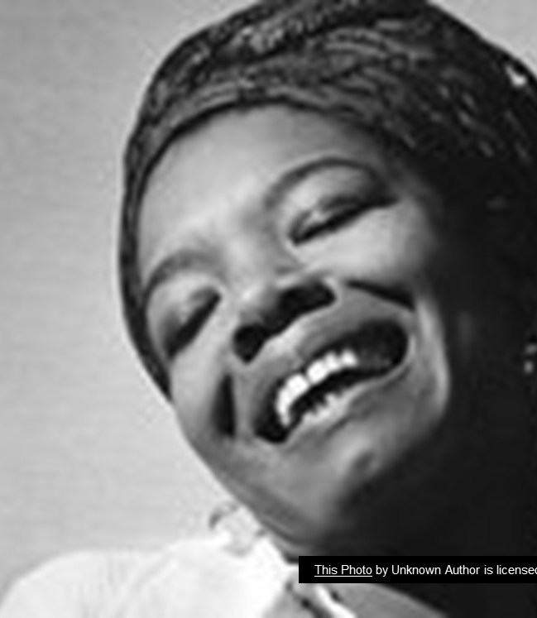
Why we do this?
“I've learned that people will forget what you said, people will forget what you did, but people will never forget how you made them feel.”
Maya Angelou

Slide 16
Training Inquiries
For inquires about the full Coach Approach Training contact Ellen B. Kagen ellen.b.kagen@gmail.com
Cell: 301-651-9850
For inquires about the Coach Approach and statewide training contact Mark B. Durgin durginm@upmc.edu
Cell: 717-678-9166

